Slide 1

Marketing Presentation for Thai To Go
JANET CHU HUI CHENG / 156Z
http://thaitogo.sg
Notes:
*Introduction (1 minute)*
Good afternoon], everyone. Today, I am excited to present our strategic marketing plan designed to boost Thai To Go's business performance, particularly focusing on increasing our sales turnover by 10% over the next six months."

Slide 2
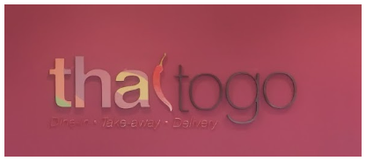
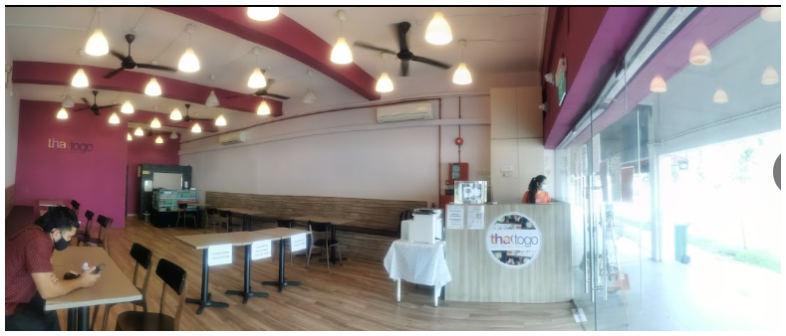
Company Background
Our Story
For over 10 years, Thai To Go has been serving up delicious halal Thai dishes near Eunos MRT, becoming a beloved fixture in Singapore's vibrant culinary landscape.
Thai To Go: A Decade of Authentic Halal Thai Cuisine
Our Commitment
We're dedicated to bringing the rich flavors of Thailand to your table, whether you're dining with us or enjoying our food at home.
Notes:
*Overview:* “
As you know, Thai To Go has been serving authentic Halal Thai cuisine in Singapore for over a decade.
Our goal is to not only sustain our reputation but also expand our market share by adapting to the changing needs of our customers in this post-pandemic era."

Slide 3
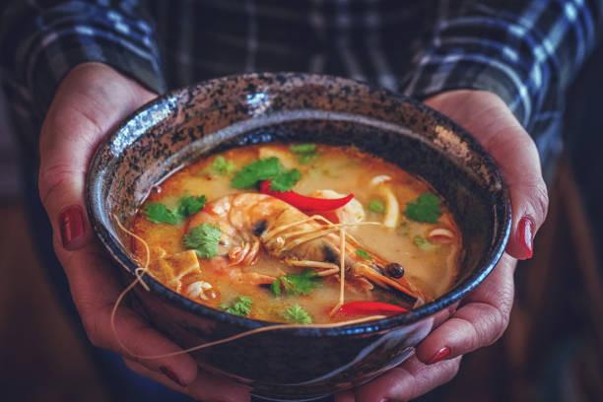
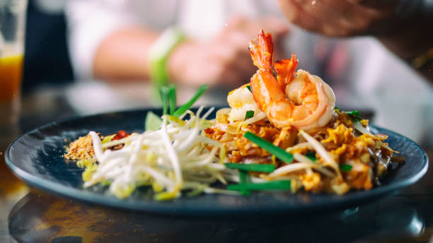
Experience Authentic Thai Flavors in Singapore’s Heartlands
ORDER & PICKUP SERVICES
DINING IN OR DELIVERY SERVICES

Slide 4
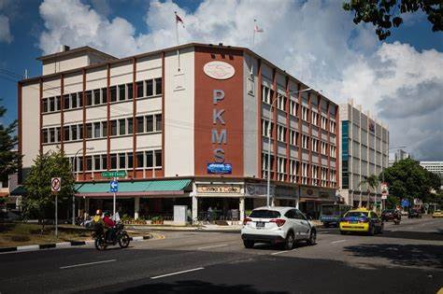
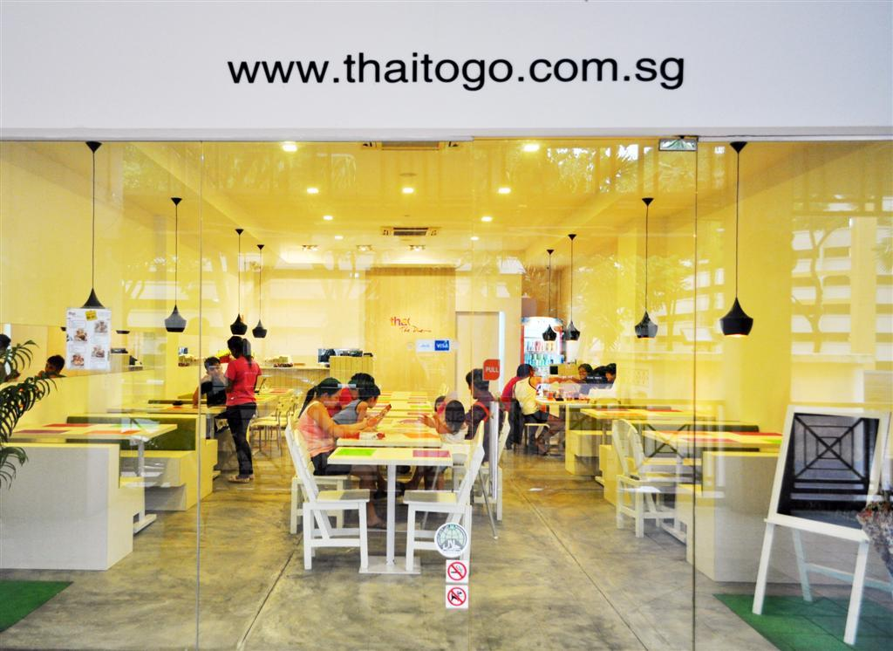
Heart of Eunos
Thai To Go is located at 218B Changi Road, Singapore 419737.
This address is on the first floor of the PKMS Building in the Eunos area of Singapore.
The restaurant's operating hours are:
Monday to Saturday: 10:30 AM to 9:00 PM (last order at 8:30 PM)
Sunday: Closed
Notes:
*Company Background *Summary:*
"Thai To Go is a beloved fixture in Singapore's culinary scene, known for its delicious, Halal-certified Thai dishes.
Our commitment has always been to bring the rich flavors of Thailand to your table, whether you’re dining in, picking up, or ordering for delivery."- *

Slide 5


OUR HALAL PROMISE
As a certified halal establishment, we ensure our Thai delicacies are accessible to all, regardless of dietary restrictions
What We Offer in our Menu and Services provided:
Dine-In Experience: Savor the ambience and flavors at our restaurant
Convenient Pickup: Order ahead and collect at your right time
Island-Wide Delivery: Enjoy our dishes anywhere in Singapore
Mini Catering: Perfect for gatherings of 10 or more.
Notes:
As a certified halal establishment
We Offer :
Dine-In Experience,, Convenient Pickup: Island-Wide Delivery Mini Catering

Slide 6
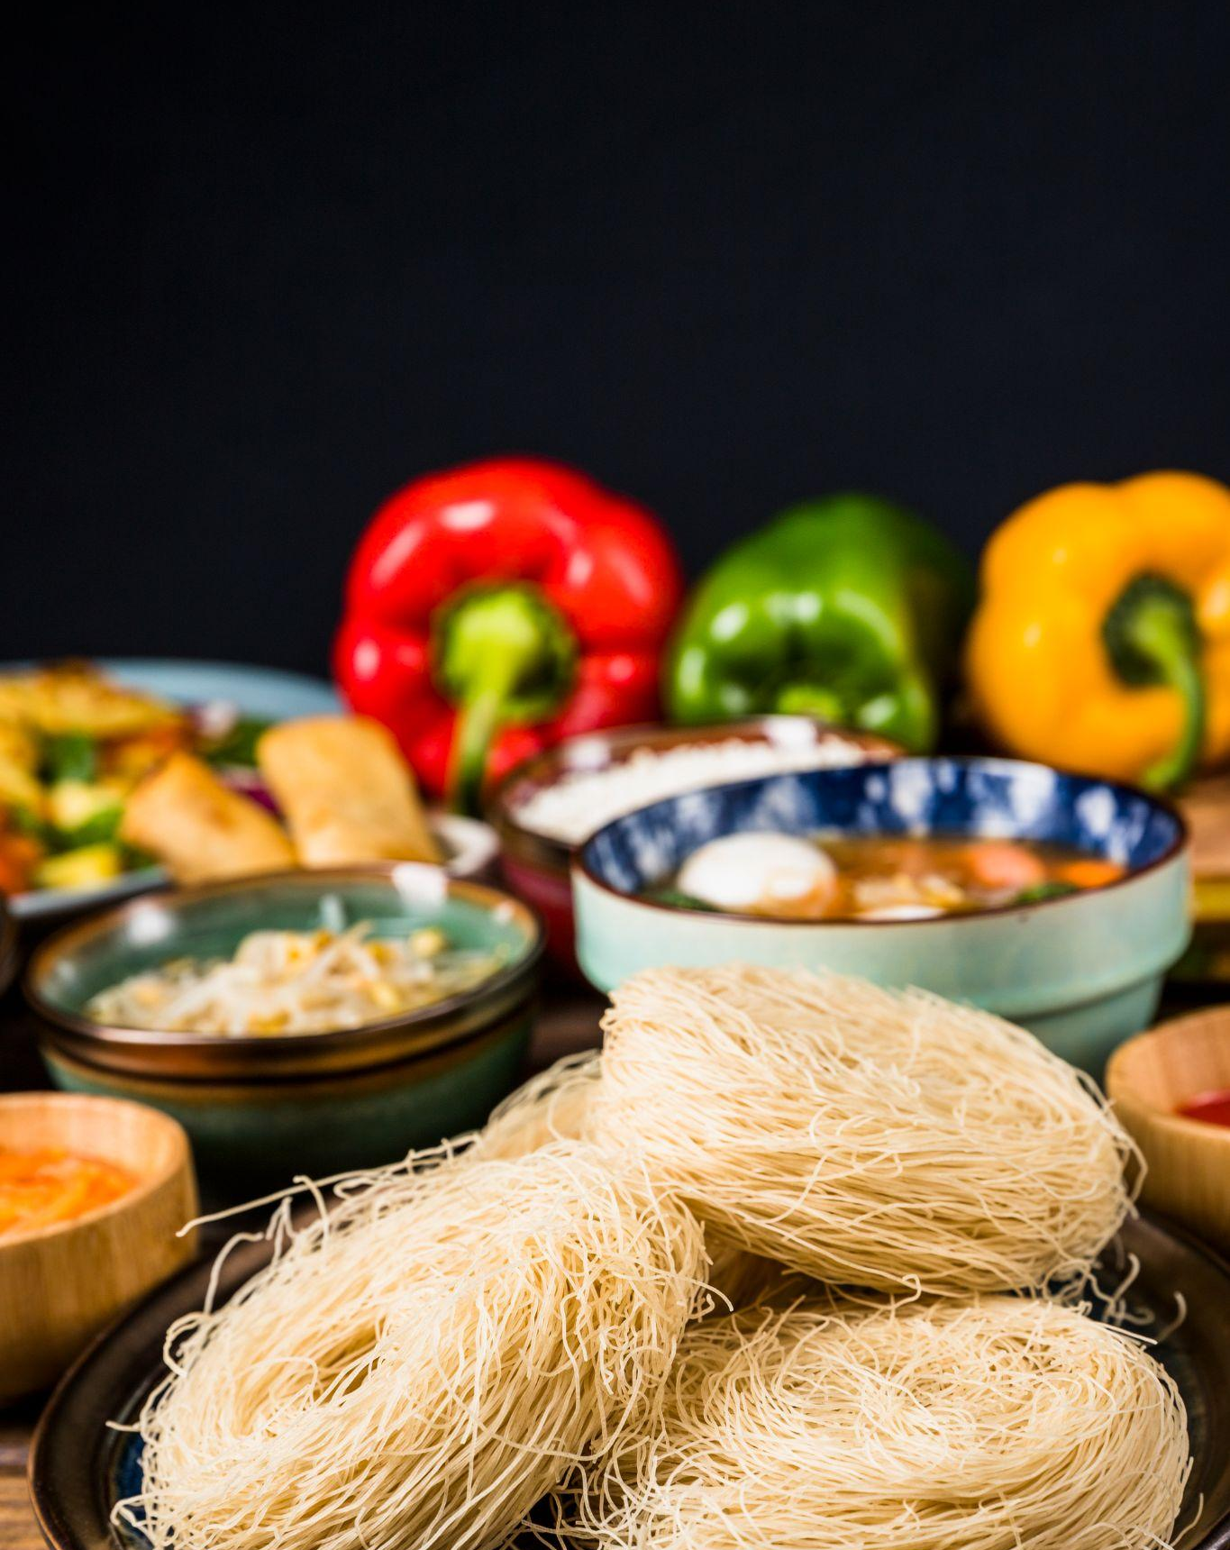
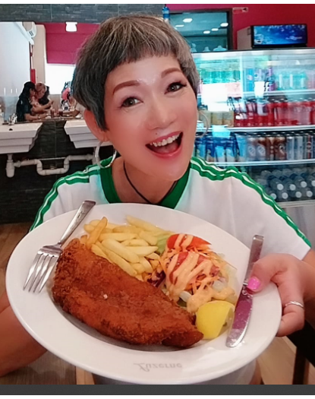
Unique Value Proposition
Affordable and Homely Cuisine
Halal Certification for trust and dietary compliance
Unique Fusion Menu blending Thai, Malay, and Western dishes
Convenient Catering Services
Personalized Customer Experience
Exclusive Location near Eunos MRT

Slide 7
Problem Statement Business declined due to the impact of the COVID-19 pandemic and the increase of WFH.
Pain Point
Decline in orders due to remote work policies.
Need to boost delivery and catering services to adapt to changing customer preferences.
Difficulty attracting customer attention and loyalty without in-person dining experiences.
Goals
Increase revenue from delivery and catering services.
Improve online visibility and engagement.
Enhance customer retention through loyalty programs.
Optimize menu offerings and pricing strategy.
Improve operational efficiency for better service quality.
Notes:
Current Challenges:*
"However, the COVID-19 pandemic and the shift to remote work
led to a decline in orders, especially for in-person dining.
This has necessitated a shift in focus toward our delivery and catering services to meet the changing customer preferences."

Slide 8
Marketing Plan

Slide 9
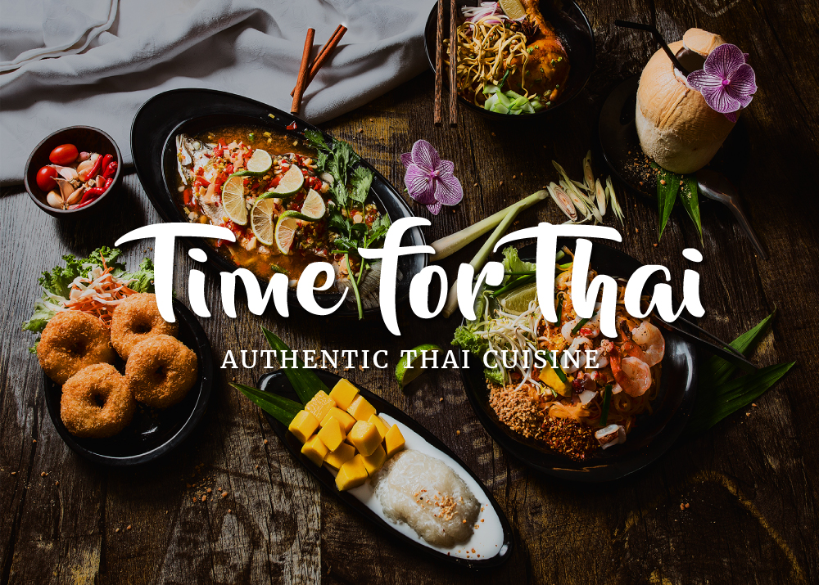
MARKET PLACE
Embrace Sustainability Initiatives
Highlight Unique Dishes and Ingredients:
Create an Engaging Online Presence
Collaborate with Influencers and Food Bloggers:
Offer Customization and Spice Levels:
Efficient Takeaway and Delivery Services
Host Thai Cultural Events:

Slide 10
Executive Summary
Marketing Plan Overview
Business Objective
To increase market share by 20% in the [target market] segment through enhanced brand awareness, customer acquisition and Boost Customers Retention.
Target Market
Thai To Go aims to attract health-conscious AND individuals WHO ARE BUSY AND FAMILY WITH YOUNGER CHILDREN AGE 3-10 YEARS OLD, residing in the local area who appreciate authentic halal Thai cuisine, seek convenient takeaway and delivery options, and value unique dining experiences.
Notes:
Marketing Goals (1 minute)*- *SMART Goals:*
"Our primary objective is to increase our market share by 20% within our target market segment by enhancing brand awareness, customer acquisition, and retention. Specifically, we aim to increase our sales turnover by 10% within the next six months."

Slide 11
Executive Summary To guide middle-income families of four in Singapore through their customer journey, Thai To Go will implement the following SEM strategies:
Awareness Stage | Consideration Stage
Channels | Channels
Google Ads: Target keywords like “family meal delivery” and “affordable Thai food” | Retargeting ads on Google and social media
Social Media Ads: Run campaigns on Instagram, tictok and Facebook | Email marketing with family meal promotions and recipes

Slide 12
Executive Summary To guide middle-income families of four in Singapore through their customer journey, Thai To Go will implement the following SEM strategies: Decision Stage Channels Google Local campaigns promoting nearby delivery options Clear CTAs on website and social media Content Limited-time offers to create urgency User-generated content to build trust
Notes:
*Marketing Strategy:*
"To reach this audience, we will implement a multi-channel marketing strategy, including: -
*Search Engine Marketing (SEM):* Targeting keywords like 'healthy Thai food' and ‘
Halal Thai dishes' through Google Ads and social media ads.

Slide 13
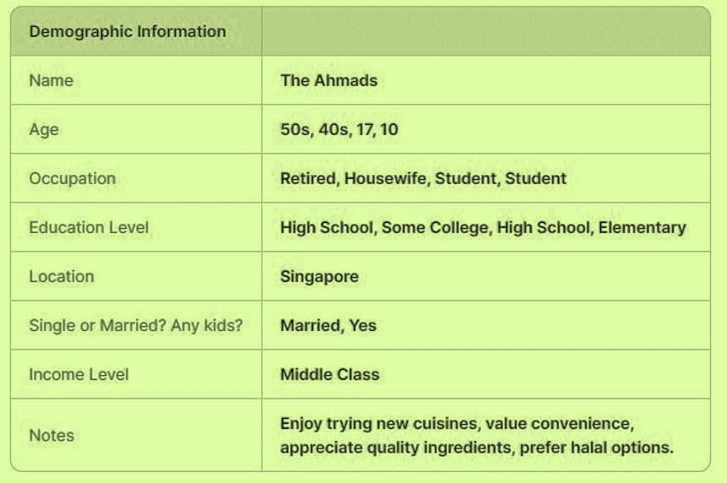

Persona / Ideal Customer
Notes:
Target Market & Strategy (2 minutes)*- *Target Audience:*
"Our target audience includes health-conscious individuals and busy families with young children who appreciate authentic Halal Thai cuisine. They seek convenient to takeaway and delivery options and value unique dining experiences."

Slide 14
Persona / Ideal Customer
Demographic Information
Notes | Enjoys playing video games, a foodie, attends tech meetups, prefers quick meal options, reads tech blogs and watches YouTube tech reviews Owns a smartphone, laptop, and gaming console; heavy user of food delivery apps; active on Reddit, Twitter, and YouTube; subscribes to tech updates and food deals

Slide 15
Persona / Ideal Customer
Demographic Information
Notes | Find quick and tasty meal options; explore various cuisines; balance work schedule with healthy lifestyle; stay informed about tech trends and food deals Limited time to cook; prefers single-serving meal options; looking for affordable meals without compromising on taste; needs fast delivery options Prefers online ordering; looks for tech-friendly features; relies on reviews and ratings; enjoys loyalty rewards and discounts

Slide 16
Persona / Ideal Customer
Psychographic Information
Life stage | Married, early 30s
Pain Points | Limited time to cook, prefers precooked-serving meal options, looking for convenient and preferably for delivery service
Motivations | Quick and tasty meal options, exploring various cuisines, staying informed about tech trends and food deals
Challenges | Balancing work schedule with healthy lifestyle, reliable and fast delivery options
Core Values & Beliefs | Tech-savvy, values convenience and efficiency, enjoys trying new things, appreciates loyalty rewards

Slide 17
Persona / Ideal Customer
Service Needs & Preferences / Factors
Online Behaviour | Abdullah is very active online. He uses food delivery apps, social media, and tech blogs to stay informed about food and tech trends. He also relies on reviews and ratings when making decisions.
Preferred Communication Channels | Social media, facebook, Instagram, ticktok & email newsletters, food delivery apps notifications, YouTube recommendations
Service Expectations | Fast delivery, affordable and tasty meal options, easy-to-use online ordering system, family meal options
Price Sensitivity | Affordable home-cooked meal with varities options but values occasional discounts and loyalty rewards
Notes:
*Social Media Engagement:*
Running campaigns on Instagram and Facebook, showcasing our dishes and health benefits.

Slide 18
Persona / Ideal Customer
Decision Making Process
Information Sources | Online reviews (Google, food delivery apps) Social media platforms (Instagram, Facebook) showcasing photos and reviews Recommendations from friends and colleagues
Influencers | Food bloggers reviewing Thai cuisine Social media personalities recommending Thai To Go Positive online reviews from satisfied customers
Barriers to entry | Food bloggers reviewing Thai cuisine Social media personalities recommending Thai To Go Positive online reviews from satisfied customers
Decision Triggers | Craving delicious and flavorful Thai food Short on time to cook at home Special promotions or discounts offered by Thai To Go Positive online reviews highlighting taste and convenience
Notes:
*Customer Retention:*
Enhancing customer loyalty through targeted email marketing, offering promotions, and sharing customer testimonials."

Slide 19
SWOT Analysis of the Company
Category | Factors
Strengths | * Strong brand identity and reputation * Efficient delivery system * Wide range of menu options, including vegetarian and vegan * Loyal customer base
Weaknesses | * Dependence on third-party delivery services * Limited geographic reach * Potential for food safety issues * High competition in the food delivery market
Opportunities | * Expanding delivery radius * Introducing catering services * Leveraging social media for marketing * Collaborating with other businesses for promotions
Threats | * Economic downturn impacting consumer spending * Rising food costs * Negative publicity due to food safety incidents * New competitors entering the market
Notes:
Strengths -- We have strong brand identity and reputation with wide range of menu options to cater for local customer base
Weaknesses - Dependence of 3rd party delivery services eg Lalamove

Slide 20
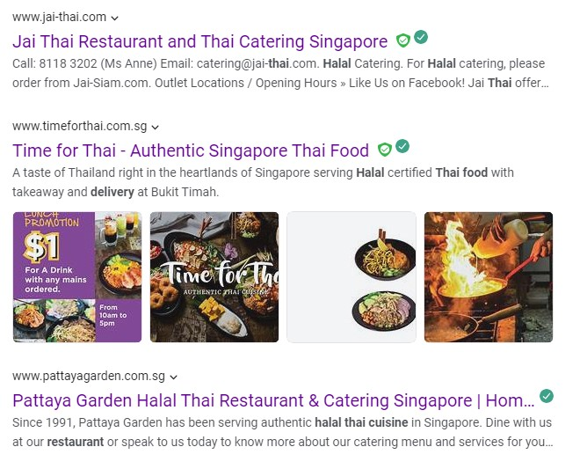
Competitive Analysis - Website
Google Keyword search use “Halal Thai Food Delivery in Eunos”

Slide 21
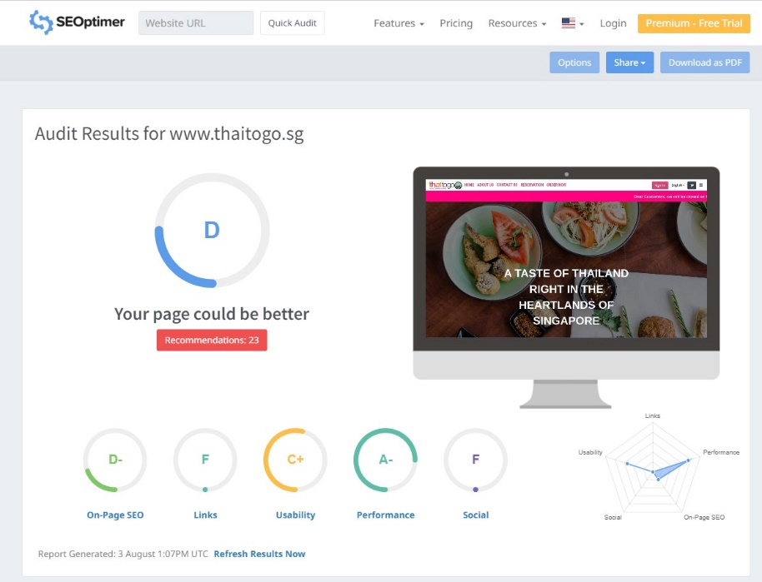
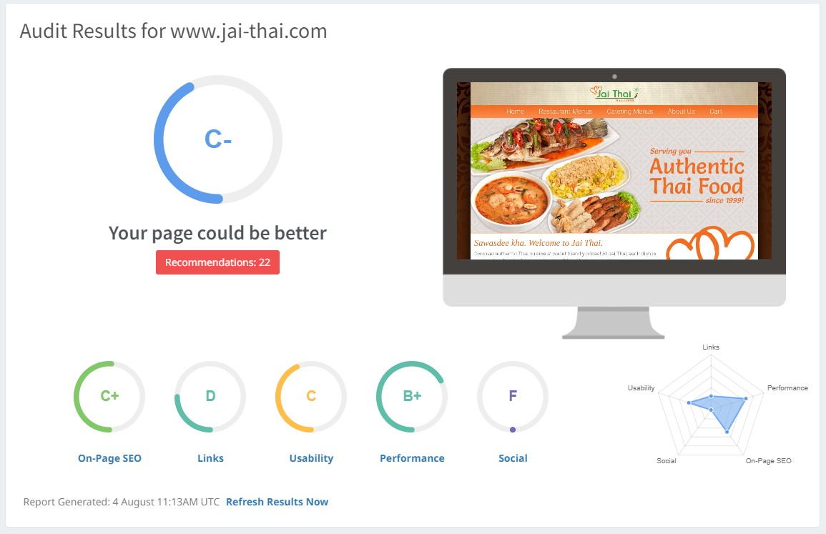
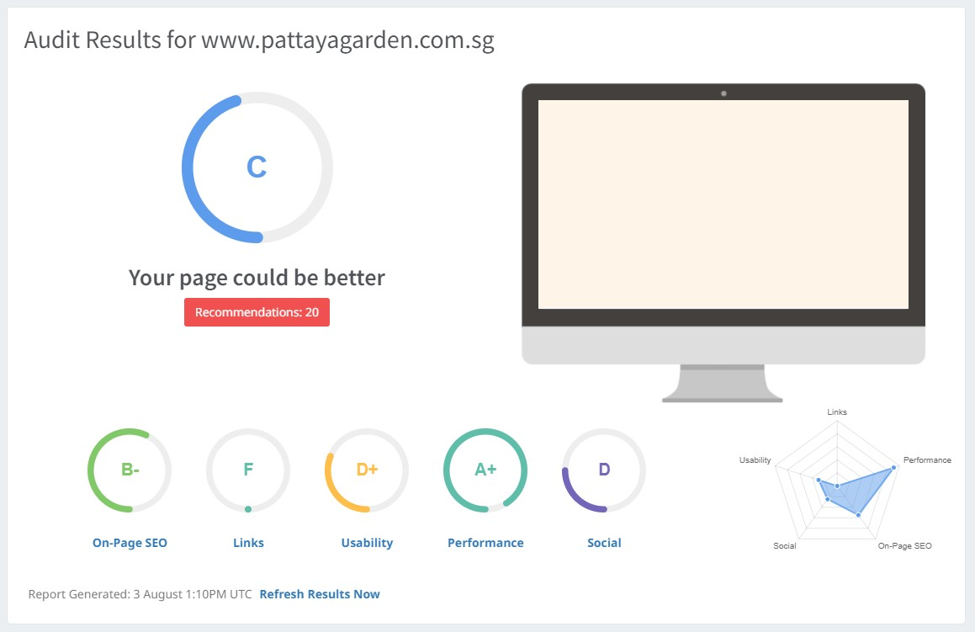
Competitive Analysis - Website

Slide 22
Competitive Analysis - Website
PATTAYAGARDEN.COM.SG
THAITOGO.SG

Slide 23
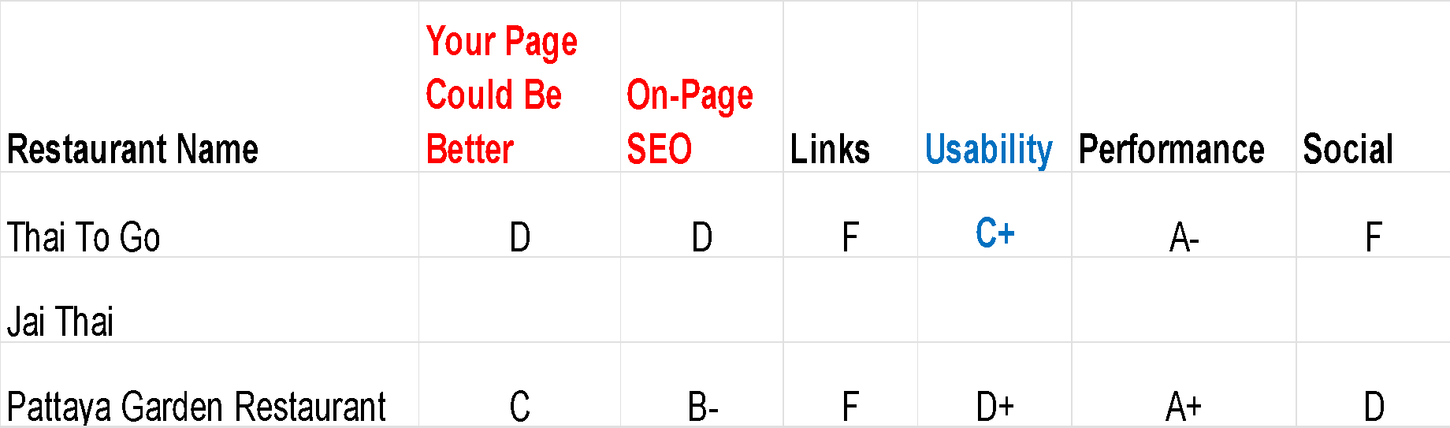
Competitive Analysis - Website

Slide 24
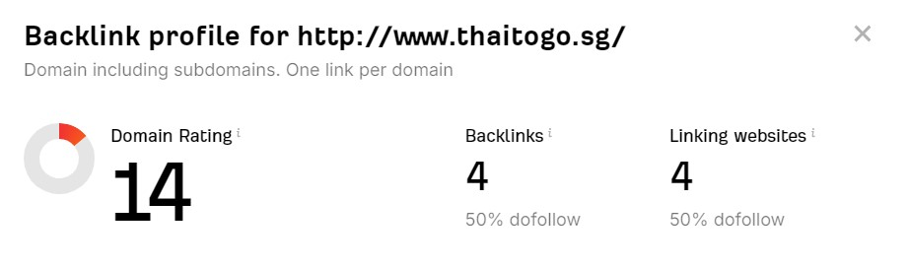
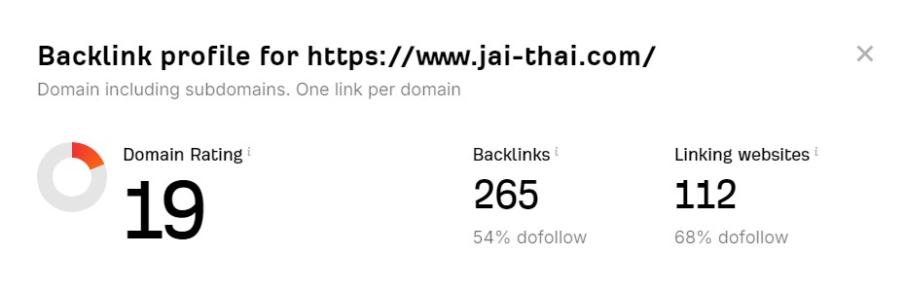
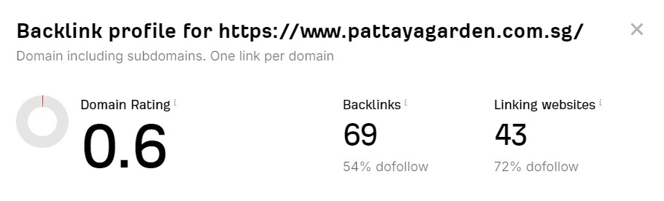
Competitive Analysis - Website Backlink
Use of Ahrefs to see Backlink Checker

Slide 25
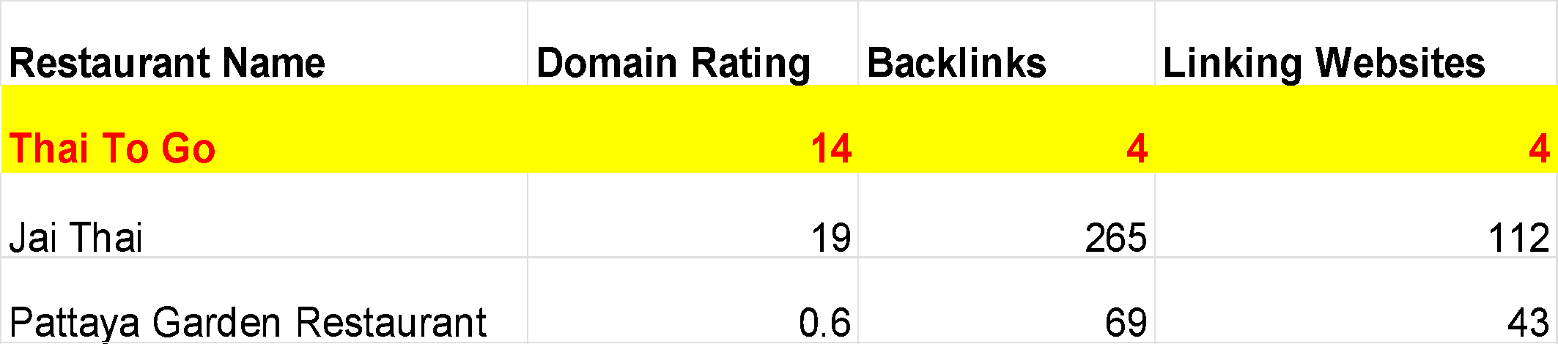
Backlink Analysis - Website Backlink
Setup and improve backlink
Backlinks: Your Website's Popularity Contest
Think of backlinks as votes of confidence for your website. They're links from other websites to yours. More and better backlinks mean higher search engine rankings, more visitors, and a stronger online reputation.
Notes:
Backlinks: Your Website's Popularity Contest
Think of backlinks as votes of confidence for your website.
They're links from other websites to yours.
More and better backlinks mean higher search engine rankings, more visitors, and a stronger online reputation.

Slide 26
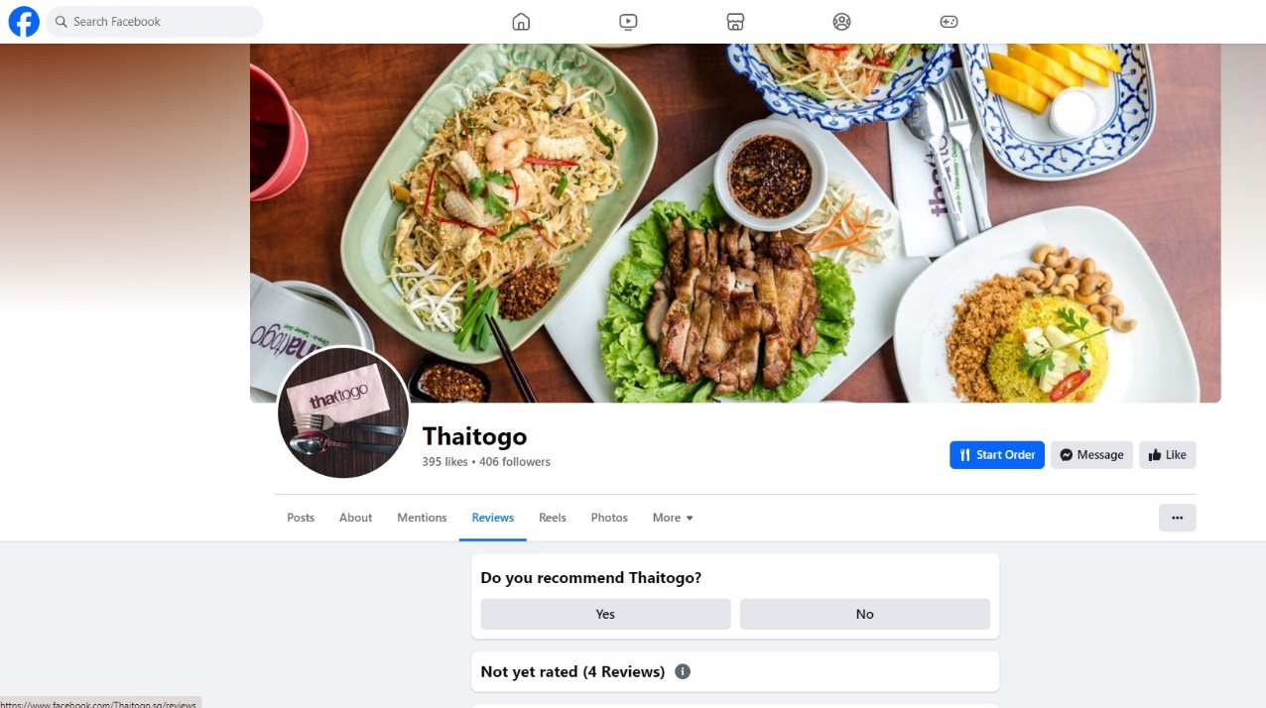
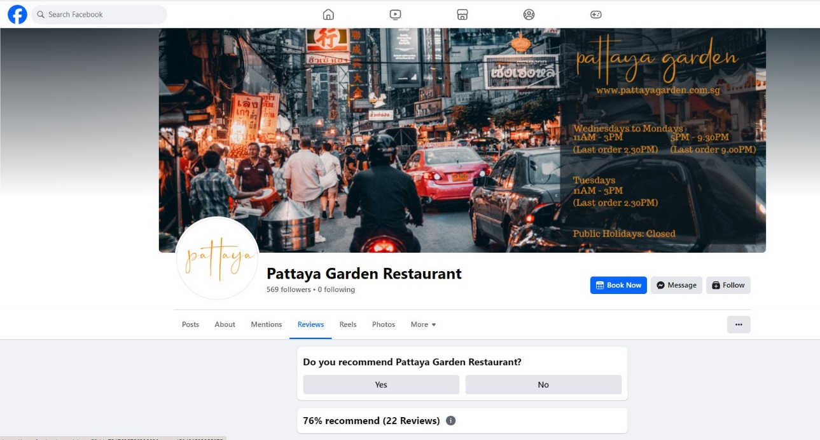
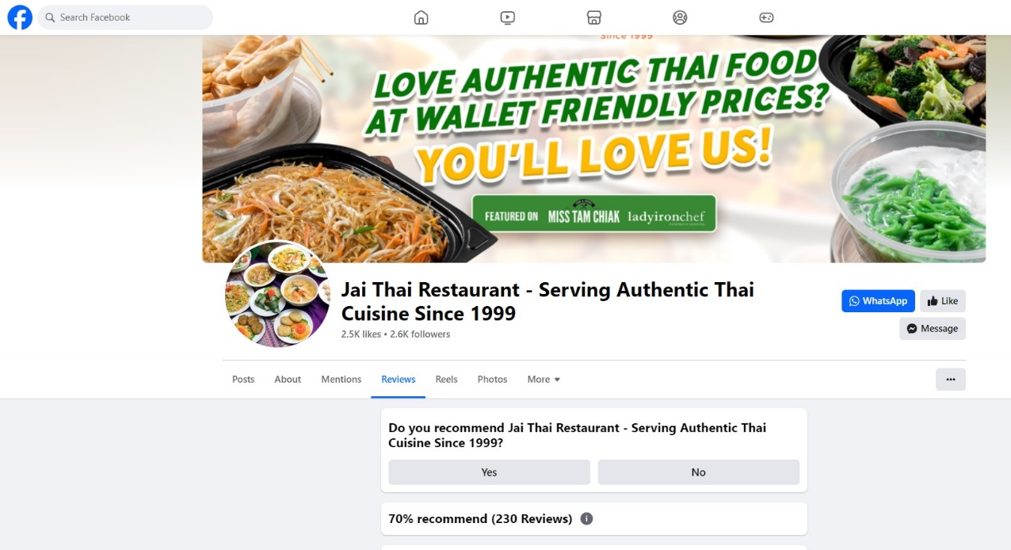
Competitive Analysis - Facebook
Notes:
Social Media Engagement:*
Running campaigns on Instagram and Facebook, showcasing our dishes and health benefits.

Slide 27
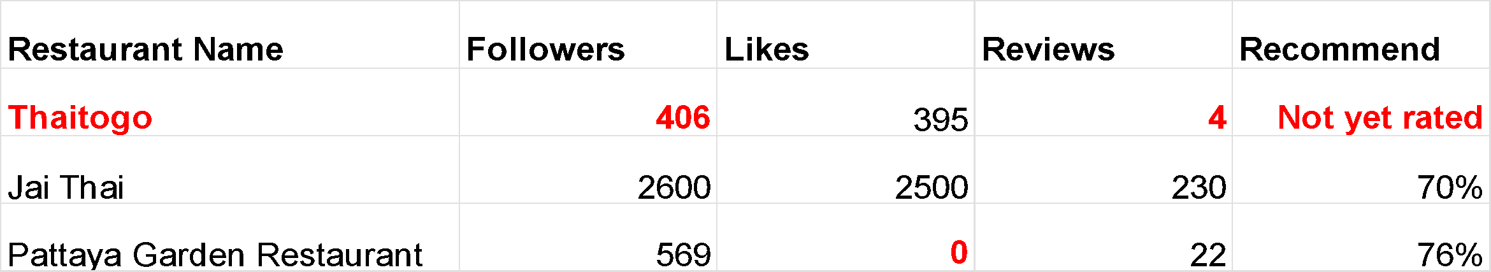
Competitive Analysis - Facebook
Followers
People who follow your account to see your content.
More followers = more potential audience.
Following
Accounts you follow to see their content.
Helps you stay updated on things you're interested in.
Reviews
Feedback from users about your content or service.
Can be positive or negative and influence others' opinions.
Recommendation Score
A measure of how often your content is recommended.
Higher score = more people are sharing your content with others.
Notes:
Competitive Analysis (2 minutes)*- *Website & Social Media:*
"Our analysis shows that while Thai To Go has a strong brand identity, there are areas for improvement in online visibility and customer engagement.
Competitors like Jai Thai and Pattaya Garden Restaurant have a more substantial social media following and better online reviews."

Slide 28
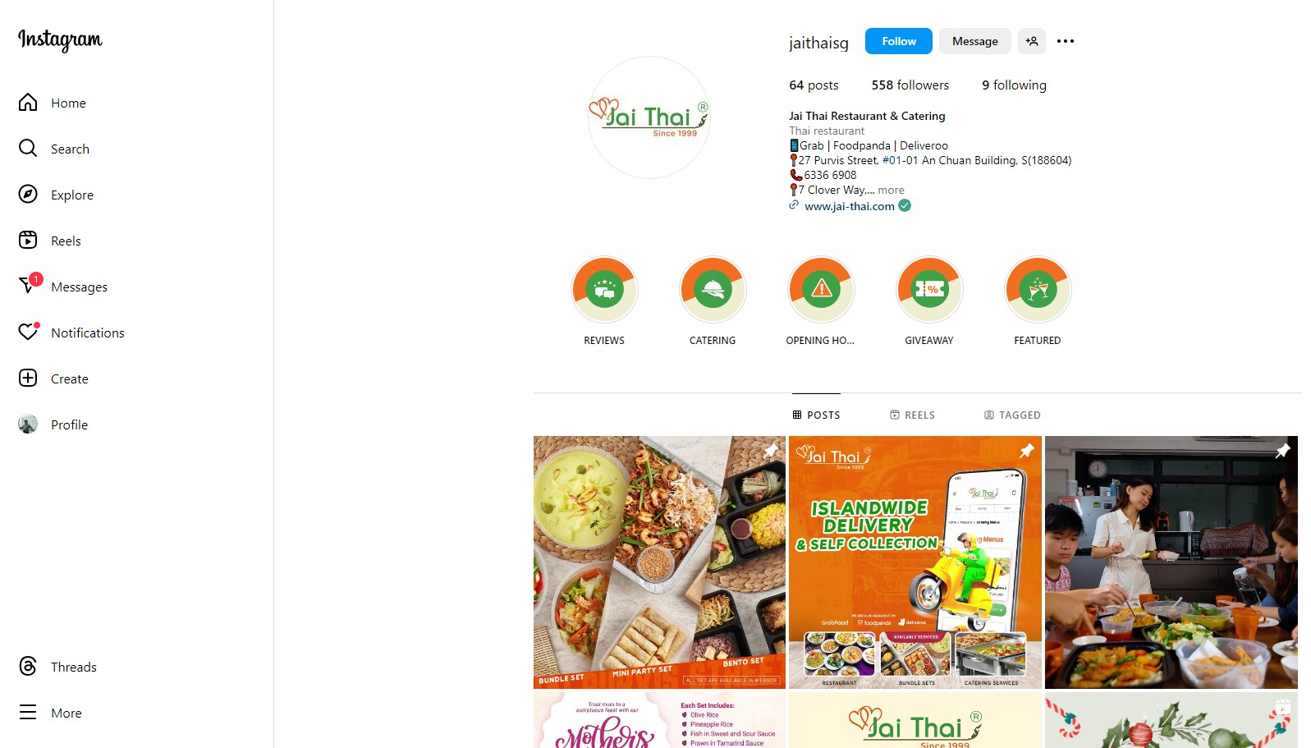
Competitive Analysis - Instagram
Notes:
Social Media Engagement:*
Running campaigns on Instagram and Facebook, showcasing our dishes and health benefits.

Slide 29
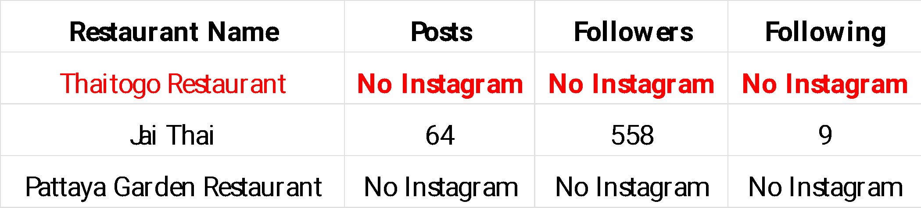
Competitive Analysis - Instagram
Instagram: Your Marketing Playground
Get Started:
Set Up Shop: Create a business account, polish your bio, and pick a great profile picture
Know Your Goals: Decide what you want to achieve (more followers, sales, etc.).
Find Your Audience: Figure out who you're trying to reach.
Plan Your Content: Mix it up with photos, videos, and stories.
Remember: Instagram is all about visuals and engagement, so make it pop!
Notes:
Marketing Strategy:*
"To reach this audience, we will implement a multi-channel marketing strategy, including:
*Social Media Engagement:*
Running campaigns on Instagram and Facebook,
showcasing our dishes and health benefits.

Slide 30
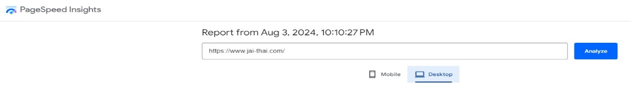
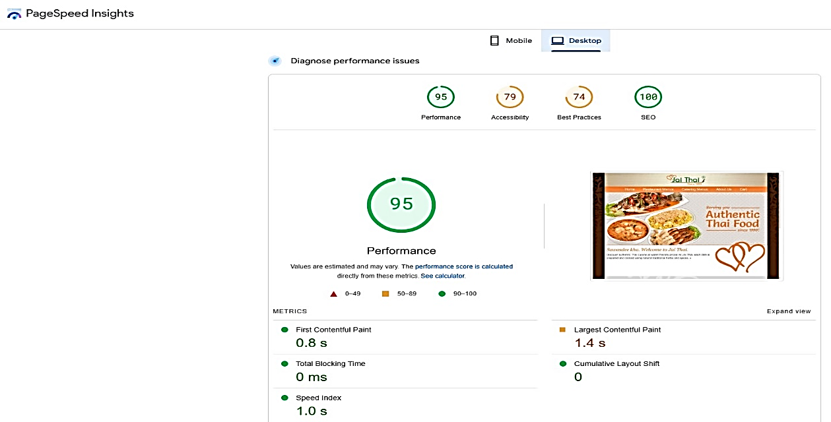
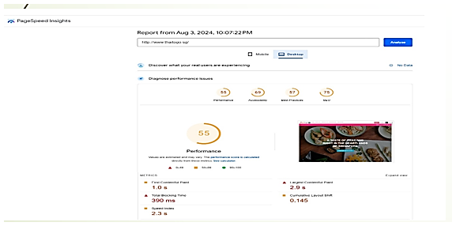
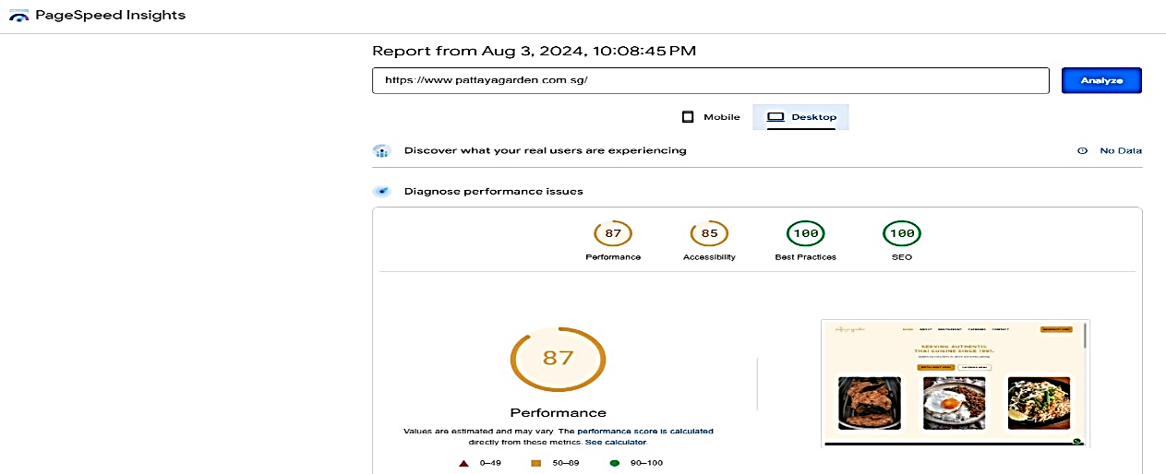
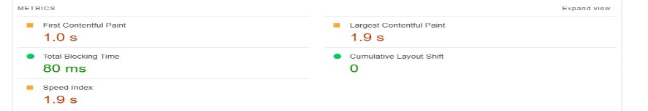
Competitive Analysis – Website Page Speed Check & Others
Jai-thai
95
Desktop
Thaitogo
pattaya
87
55
Notes:
We will optimise the resolution of the images for a faster download

Slide 31
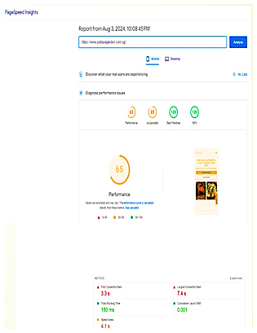
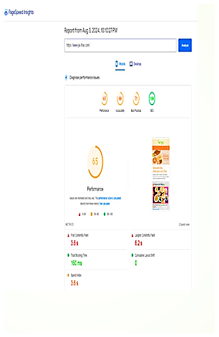
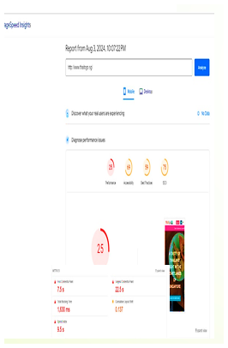
Competitive Analysis – Website Page Speed Check & Others
Mobilephone
Notes:
Optimised to bring down the download speed to 2 secs

Slide 32
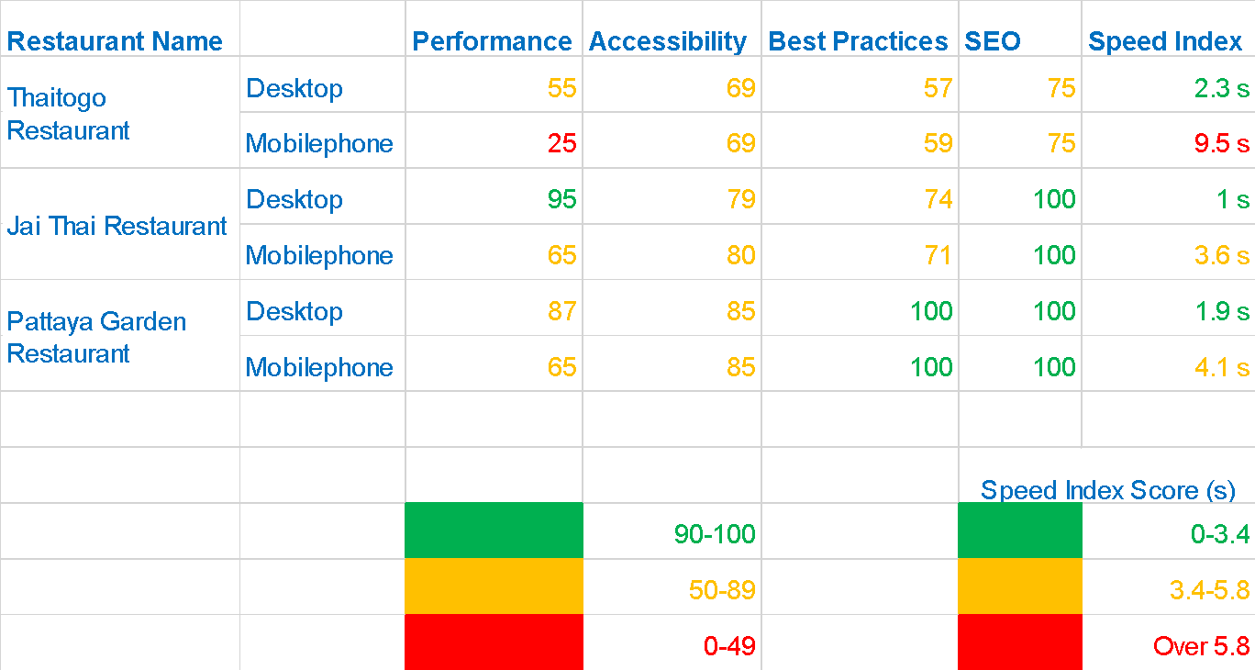
Competitive Analysis – Website Page Speed Check & Others
Notes:
To bring down the speed index to meet competitors

Slide 33
Marketing Prioritization
Here's some ways to market online delivery,
Improve on the SEO,
Google on business profile, and
Improve on the website UI/UX to make online delivery more prominent, by encouraging more testimonials for online delivery customers with positive feedback
Consider hyperlocal advertising to target areas that are more likely to order delivery as they don't have food places nearby

Slide 34
Customer Journey (Content)
Stage | Channels | Content
Awareness | Goggle Ads, Social Media, | Food Photos: High-quality images of signature dishes. Promo Videos: 15-second clips showing the ease of ordering. Discount Announcements: Posts about first-time order discounts.
Consideration | Landing Page, Retargeting ads, Email Marketing | Customer Reviews: Short testimonials from happy delivery customers. Dish Comparisons: Simple graphics comparing Thai To Go’s food to competitors. Flavor Quiz: An interactive quiz to help customers choose the right dish.
Decision | Google Local Campaigns, Website, Social Media | Limited-Time Offers: Posts promoting special discounts or free delivery. Clear CTAs: Prominent “Order Now” buttons on the website and ads. FAQ Section: Quick answers to common delivery questions, like delivery times and payment options.
Notes:
GO TO PAGE

Slide 35
Marketing Funnel
Attention
01
Social media, Google Ads, PR
Interest
02
Website, email, blogs
Desire
03
Website, email, social media
04
Action
Website, email, social media

Slide 36
Marketing Funnel
Stage | Channels | Content
Attention | Social Media, Google Ads, PR | Engaging visual, catchy headlines, short videos
Interest | Website, Email, Blogs | Informative articles, product demos, how-to guides
Desire | Website, Email, Social Media | Customer Testimonials, case studies, limited time offers
Action | Website, email, social media | Clear calls-to-action, discounts, urgency tactics

Slide 37
SMART Goals
Channel | Metric | Target KPI | Duration | Notes
Landing Page | Conversion Rate | +15% | 3 months | Optimize landing page with strong CTA and compelling content
Website | Online Orders | +20% | 3 months | Improve user experience, promote online ordering
Social Media (FB) | No. of Followers | +25% | 3 months | Engage with audience, utilize Facebook Ads
Instagram | Engagement Rate | +10% | 3 months | Focus on high-quality visuals, interactive content

Slide 38
Marketing Execution

Slide 39
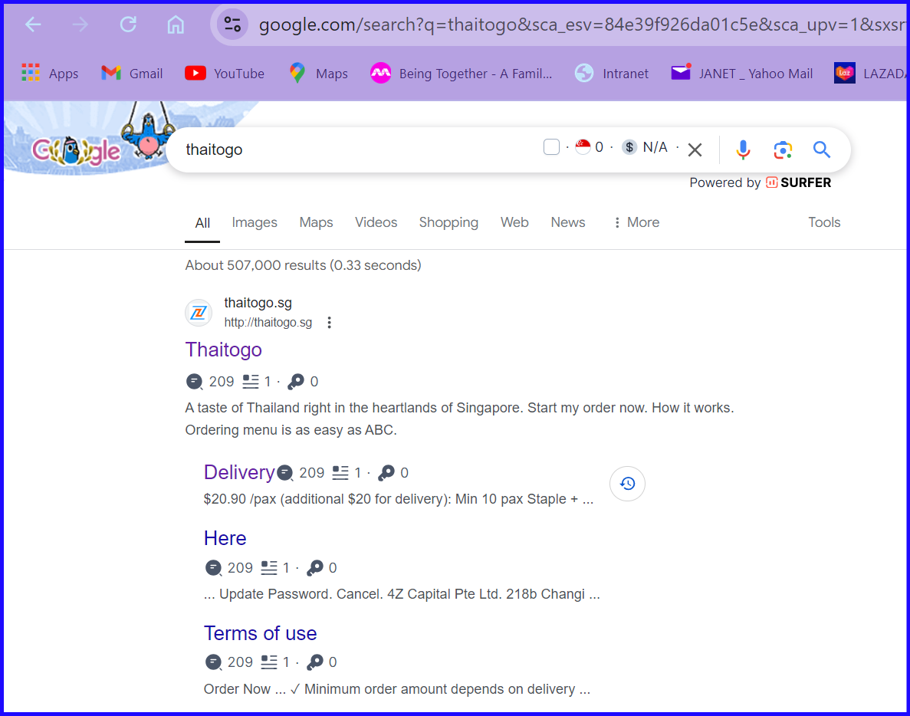
SEM - Google Search Ads
Notes:
*Opportunities:*
"We plan to improve our website’s user experience, increase social media presence, and optimize our SEO to drive more online orders.
Additionally, we will leverage influencer marketing to reach a broader audience."

Slide 40
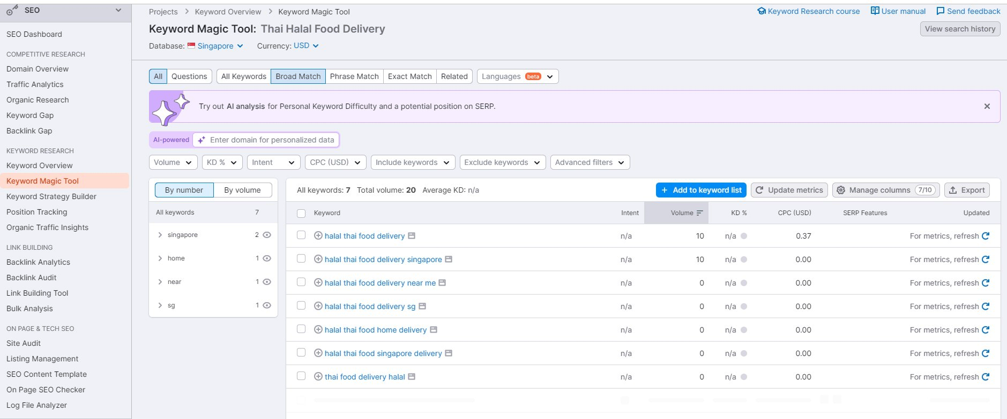
SEM - Google Keyword Search Ads
Notes:
Targeting Keywords as shown
Halal thai food delivery
……………………………..delivery in Spore
…………………………… delivery near me etc

Slide 41
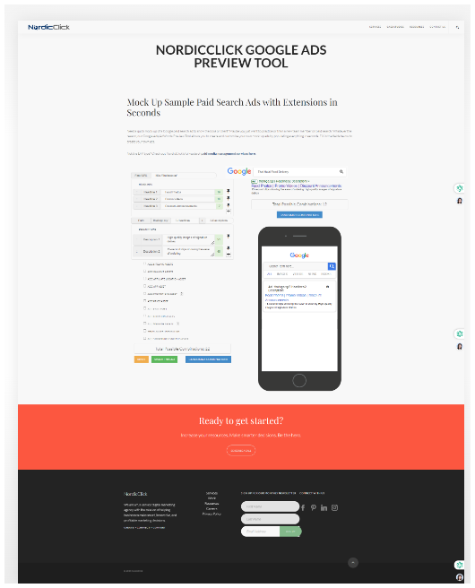
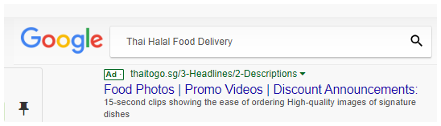
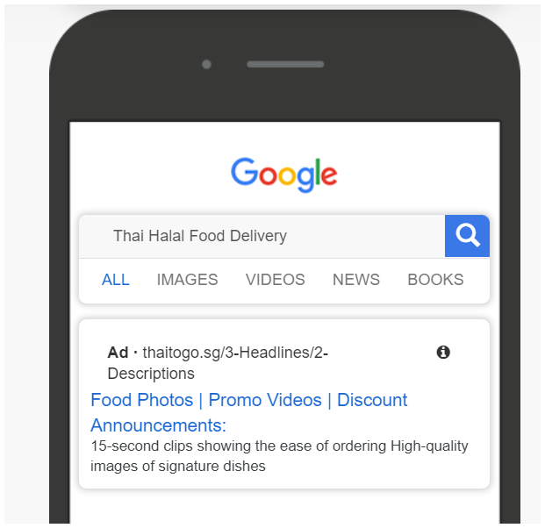
SEM - Google Search Ads (Ad mockups)
Notes:
*Search Engine Marketing (SEM):*
Targeting keywords like 'healthy Thai food' and 'Halal Thai dishes' through Google Ads and social media ads.

Slide 42
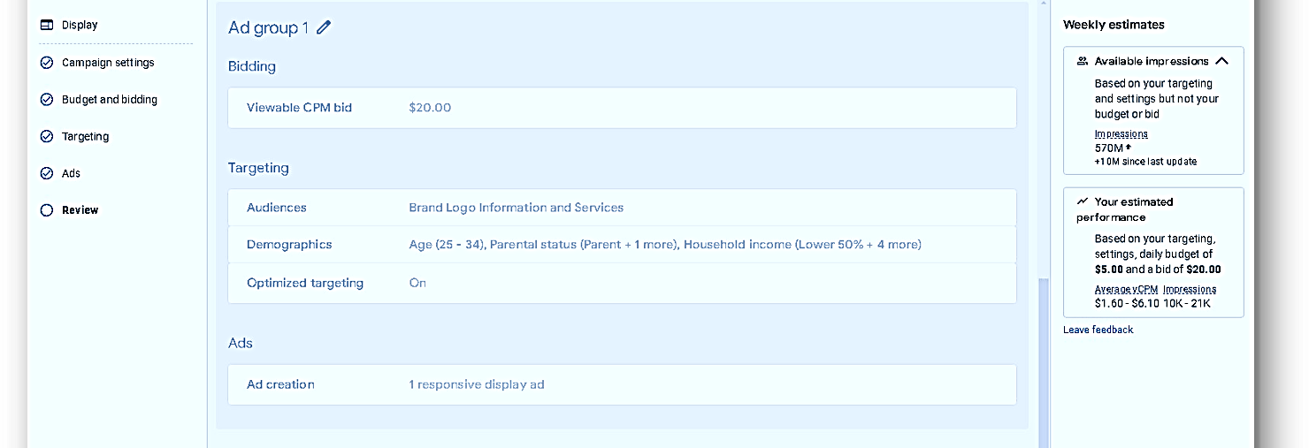
SEM - Google Search Ads
(Target Audience)

Slide 43
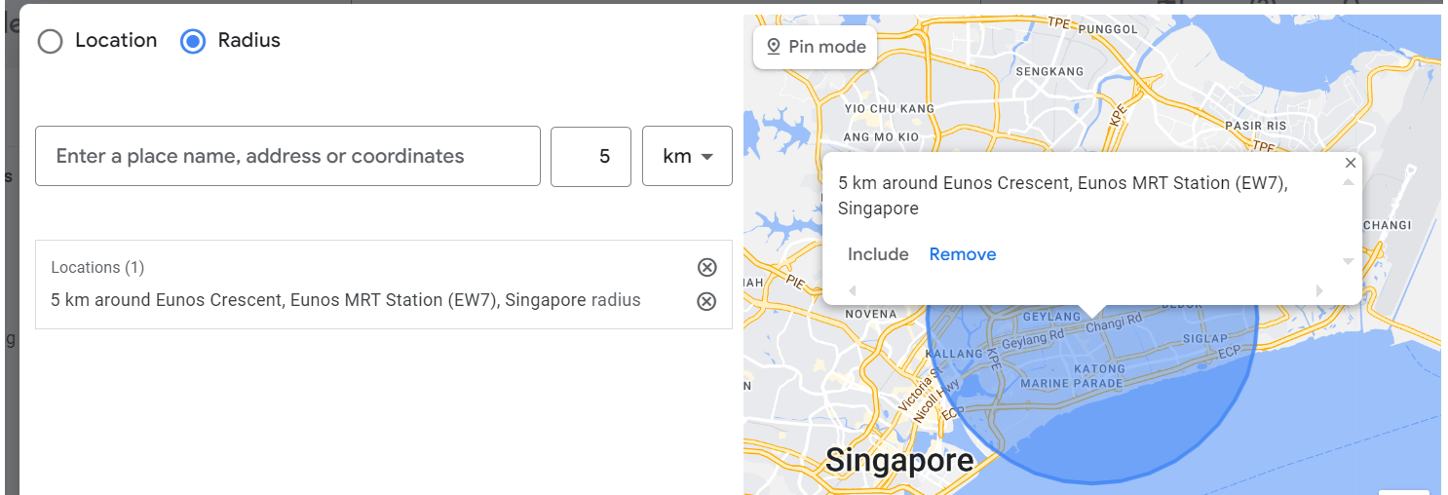
SEM - Google Search Ads (Target Audience)
Notes:
SEM google search ads (target audience within 5km)

Slide 44
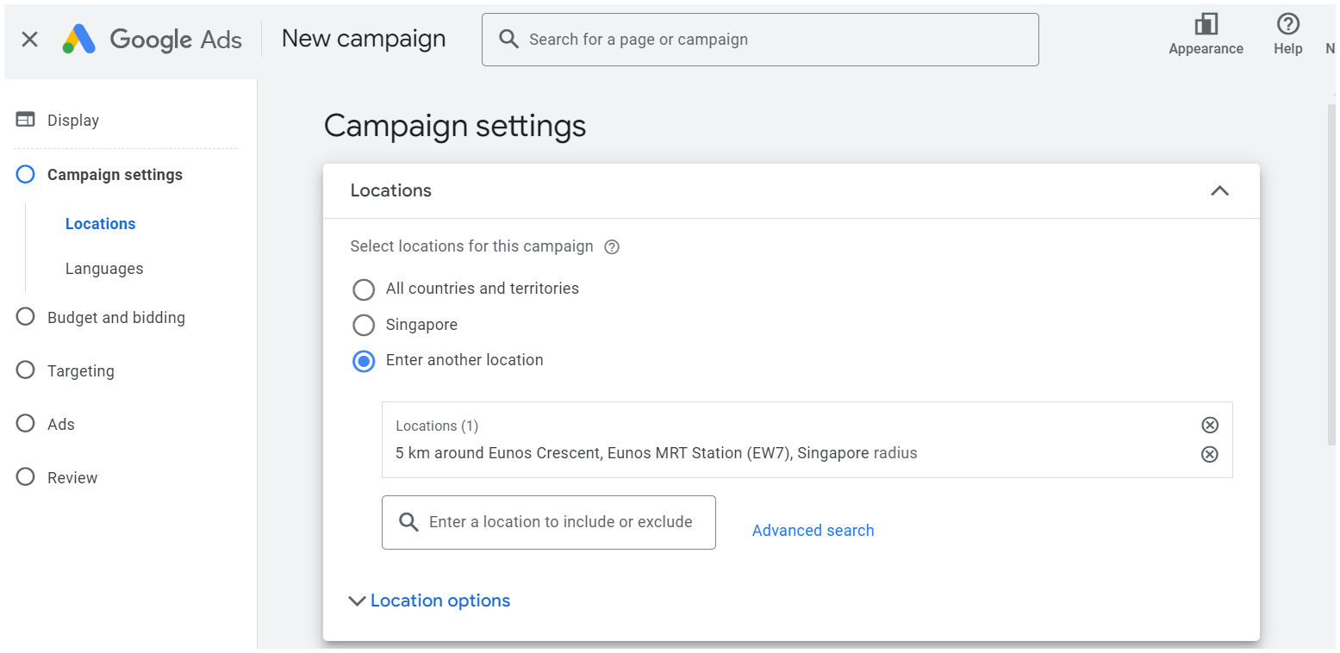
SEM - Google Search Ads (Target Audience)

Slide 45
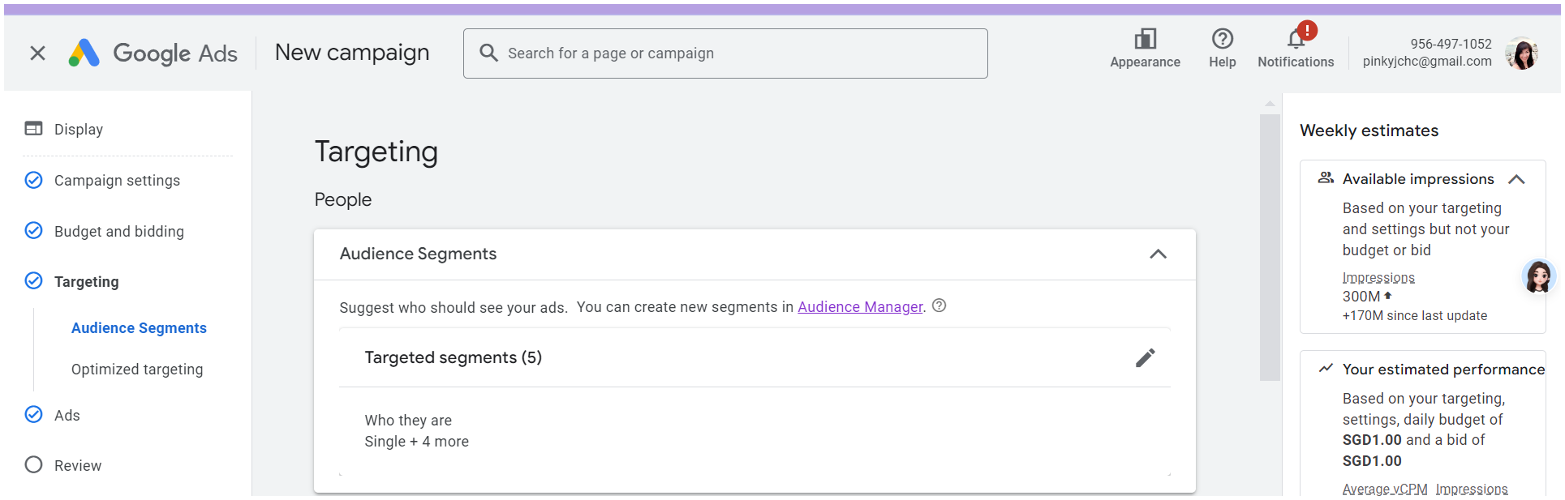
SEM - Google Search Ads (Target Audience)
Notes:
SEM Target audience

Slide 46
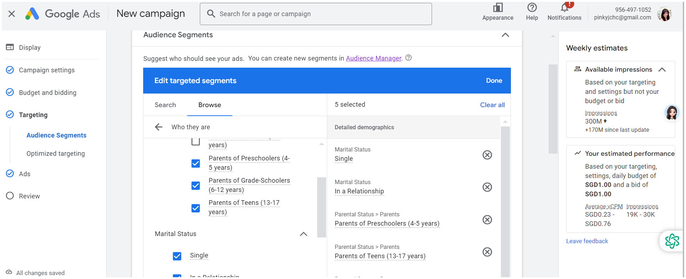
SEM - Google Search Ads (Target Audience)
Notes:
Audience Segment ( Demographic persona)

Slide 47
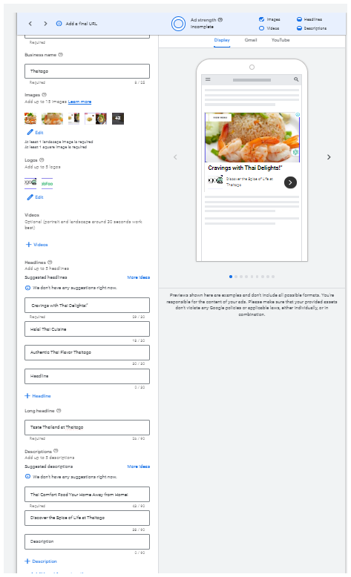
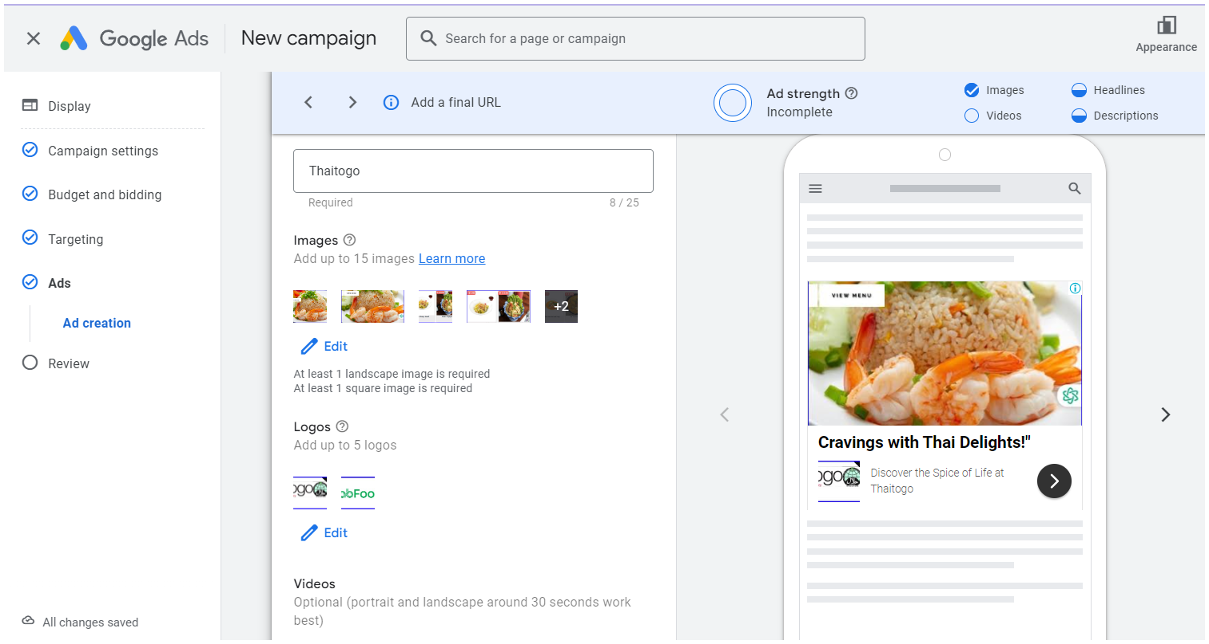
SEM - Google Search Ads (Target Audience)

Slide 48
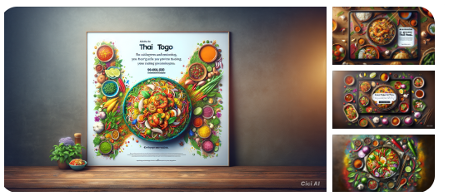
SEM - Google Display Network Ads (Target Audience)

Slide 49
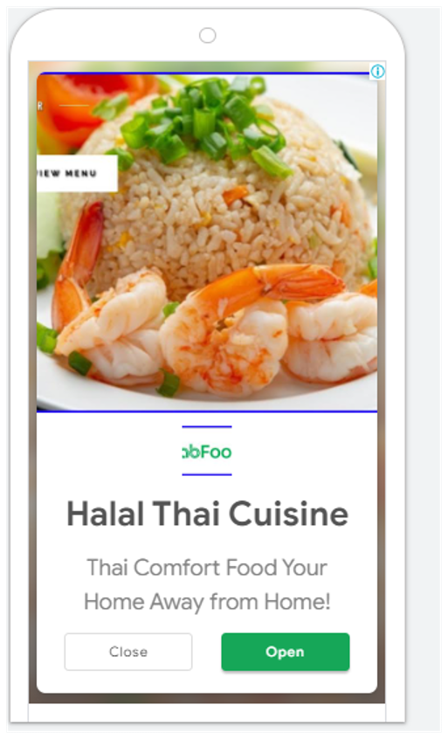
SEM - Google Display Network Ads (Target Audience) Mobile phone ads

Slide 50




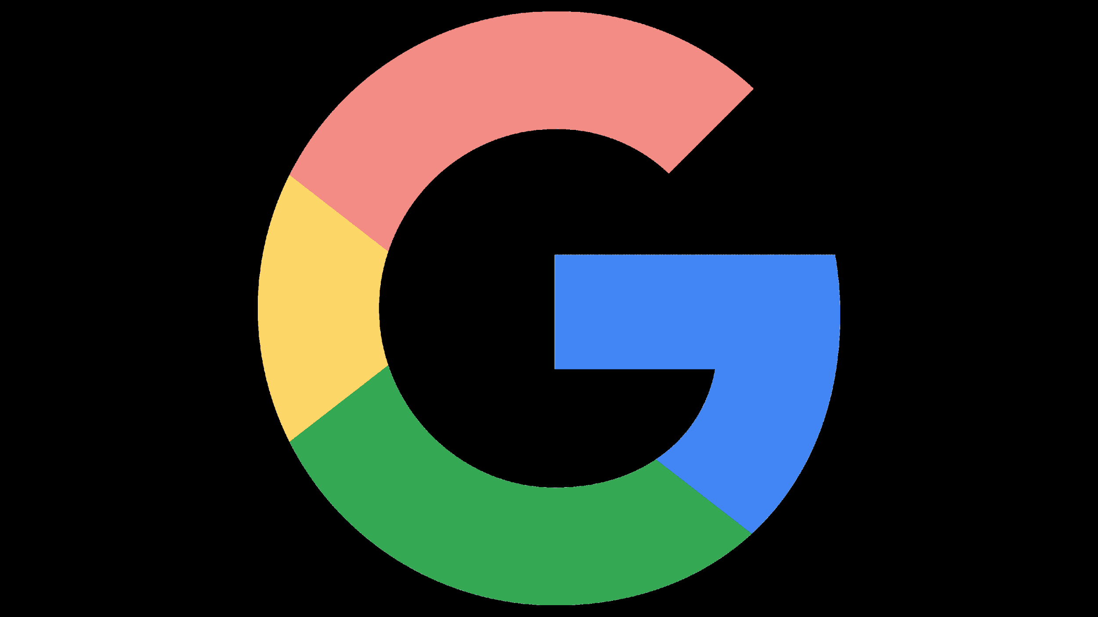
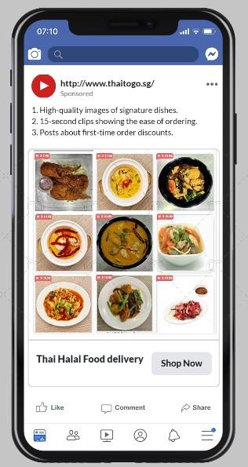




Search Engine Marketing (Google Display Network Ads)
also in mobile apps like, google, Youtube, Playstore, Chrome etc
Notes:
Social Media Posts:* High-quality visuals, interactive content, and promotional videos. -

Slide 51

Search Engine Marketing (Google Display Network Ads) https://www.canva.com/web-ads/templates/mobile-banner-ads/
Notes:
*Hyperlocal Advertising:* Targeting areas with fewer food options to increase delivery orders."

Slide 52




Search Engine Marketing (Google Display Network Ads) https://www.canva.com/web-ads/templates/halfpage-ads/

Slide 53




Search Engine Marketing (Google Display Network Ads) https://www.canva.com/web-ads/templates/billboard-ads/

Slide 54


Social Media Marketing (Ad) Instagram
Desktop Instagram
Mobile Phone Instagram

Slide 55

Social Media Posts (Ads) Face book

Slide 56


Social Media Posts (Ads) Face book
Mobile Phone FB
Desktop FB Ads

Slide 57

Landing Page
Notes:
*Landing Pages:* Optimized for conversion, with clear CTAs and customer testimonials. -

Slide 58

Landing Page

Slide 59

Landing Page

Slide 60

Landing Page

Slide 61

Landing Page

Slide 62



Landing Page
Notes:
*KPIs:* "We will measure our success through specific KPIs, including:
20% increase in online orders. -
15% increase in landing page conversion rates. -
25% growth in our social media following."

Slide 63



Landing Page
Notes:
Conclusion –
*Call to Action:* "In conclusion, this comprehensive marketing plan is designed to address the
challenges we face and capitalize on new opportunities. With a focused approach and effective
execution, we are confident in achieving our goal of increasing Thai To Go’s sales turnover by 10%
in the next six months."

Slide 64

Notes:
Closing:* "Thank you for your attention”.
I look forward to your feedback and to work together on implementing this plan."

